Slide 1
AVL Tree Data Structure
Dr. Naveen Kumar
Associate Professor
Amity Institute of Information Technology
Amity University Patna

Slide 2
An AVL tree a self-balancing Binary Search Tree (BST) where the difference between heights of left and right subtrees for any node cannot be more than one.
Balance Factor = left subtree height - right subtree height
For a Balanced Tree(for every node): -1 ≤ Balance Factor ≤ 1

Slide 3
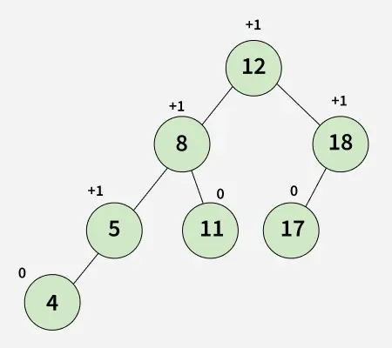

Slide 4
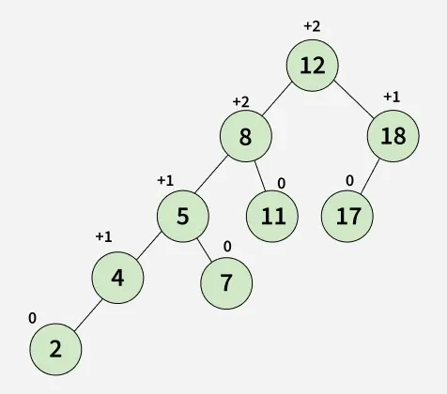

Slide 6
Operations on an AVL Tree
Searching : It is same as normal Binary Search Tree (BST) as an AVL Tree is always a BST. So we can use the same implementation as BST. The advantage here is time complexity is O(log n)
Insertion : It does rotations along with normal BST insertion to make sure that the balance factor of the impacted nodes is in the range [-1, +1] after insertion
Deletion : It also does rotations along with normal BST deletion to make sure that the balance factor of the impacted nodes is in range [-1, +1] after deletion.

Slide 7
Rotating the subtrees
Four ways to rotate to keep itself balanced while making sure that the BST properties are maintained.
1. Left-Left Case:
Occurs when a node is inserted into the left subtree of the left child, causing the balance factor to become more than +1.
Fix: Perform a single right rotation.

Slide 8
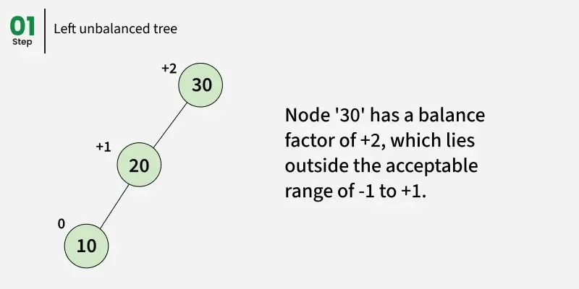

Slide 9
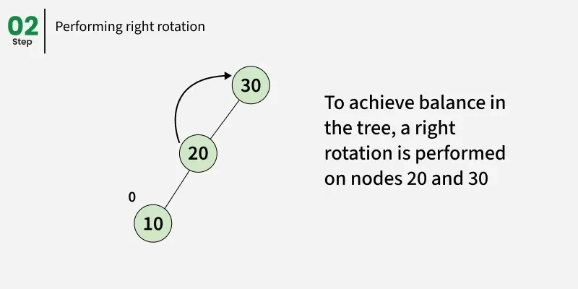

Slide 10
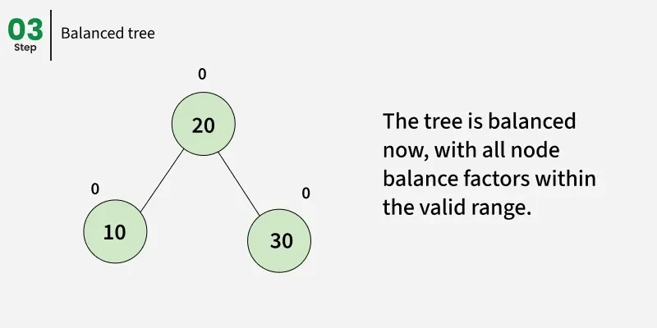

Slide 11
Rotating the subtrees
2. Right-Right Case:
Occurs when a node is inserted into the right subtree of the right child, making the balance factor less than -1.
Fix: Perform a single left rotation.

Slide 12
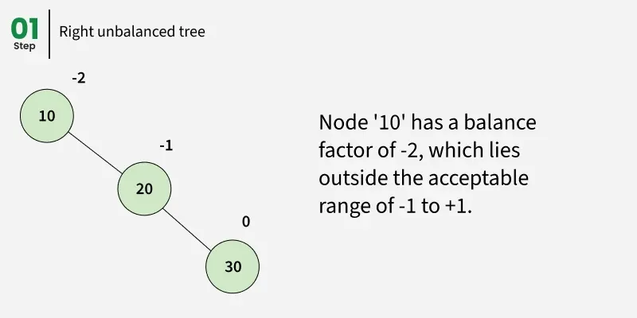

Slide 13
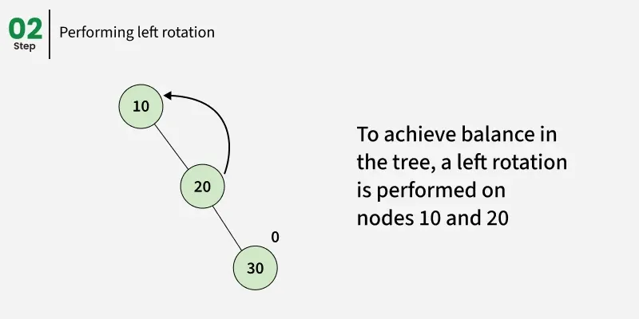

Slide 14
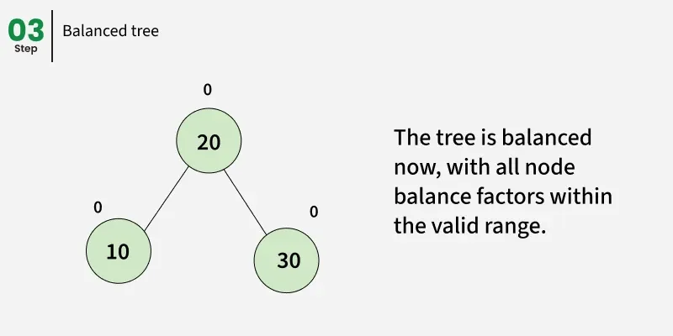

Slide 15
Rotating the subtrees
3. Left-Right Case:
Occurs when a node is inserted into the right subtree of the left child, which disturbs the balance factor of an ancestor node, making it left-heavy.
Fix: Perform a left rotation on the left child, followed by a right rotation on the node.

Slide 16
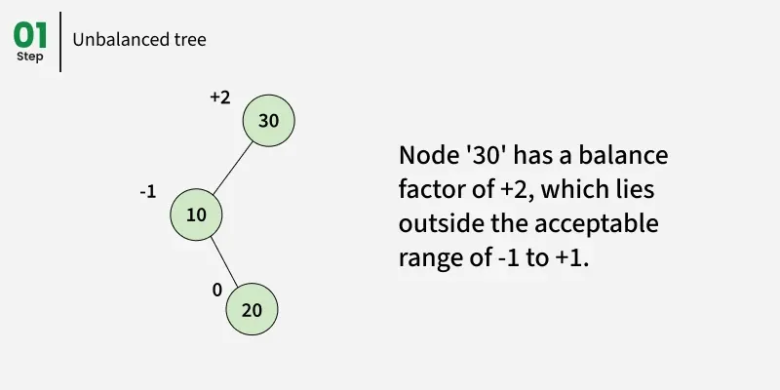

Slide 17
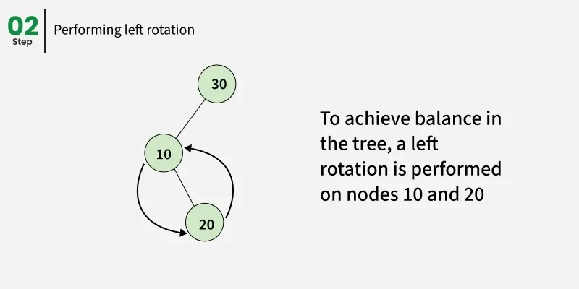

Slide 18
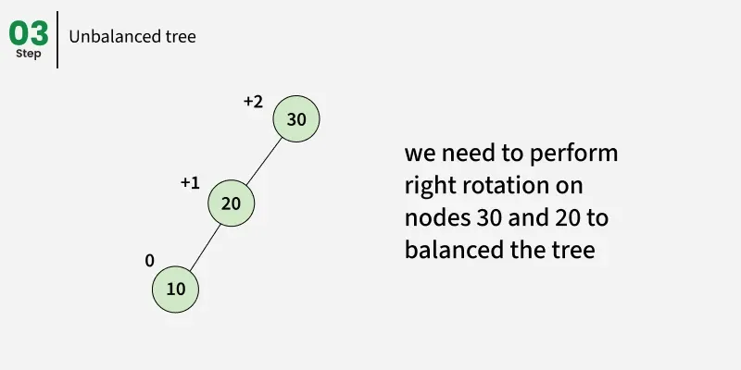

Slide 19
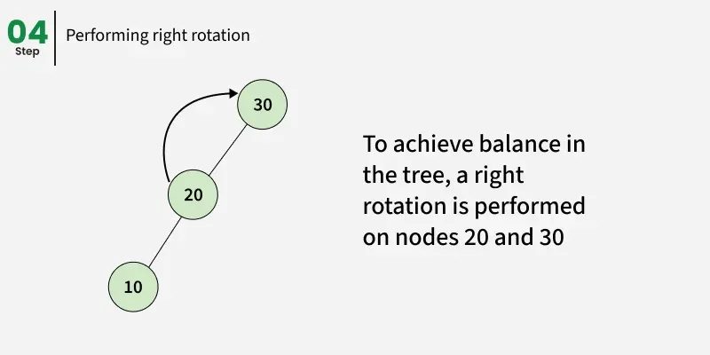

Slide 20
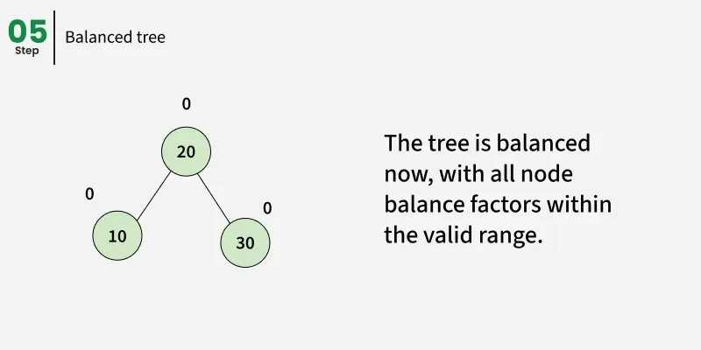

Slide 21
Rotating the subtrees
4. Right-Left Case:
Occurs when a node is inserted into the left subtree of the right child, which disturbs the balance factor of an ancestor node, making it right-heavy.
Fix: Perform a right rotation on the right child, followed by a left rotation on the node.

Slide 22
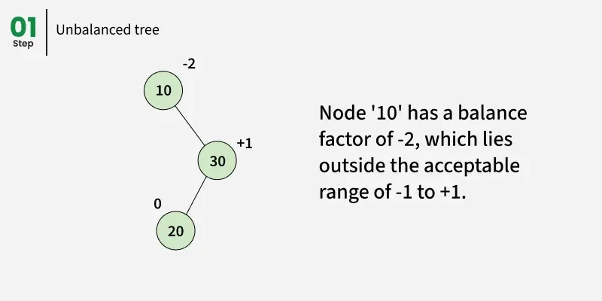

Slide 23
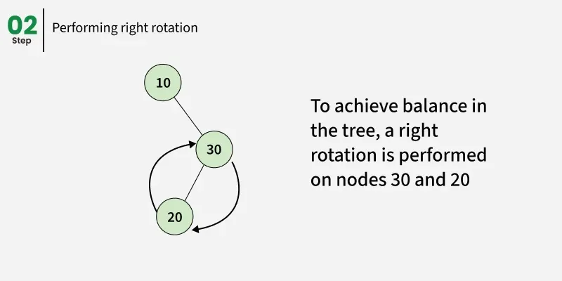

Slide 24
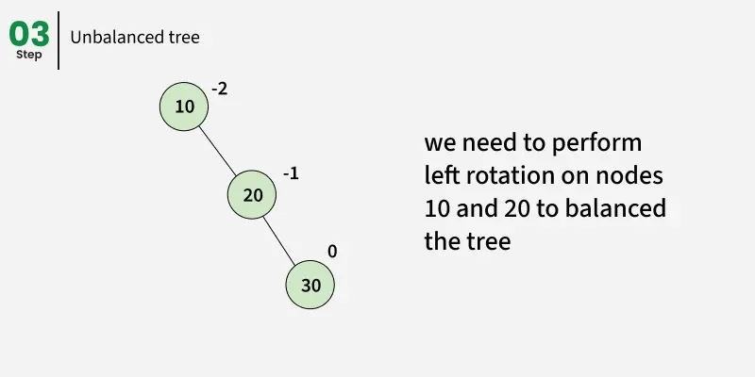

Slide 25
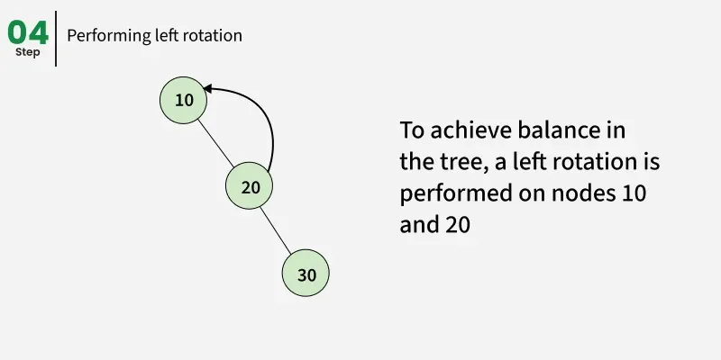

Slide 26
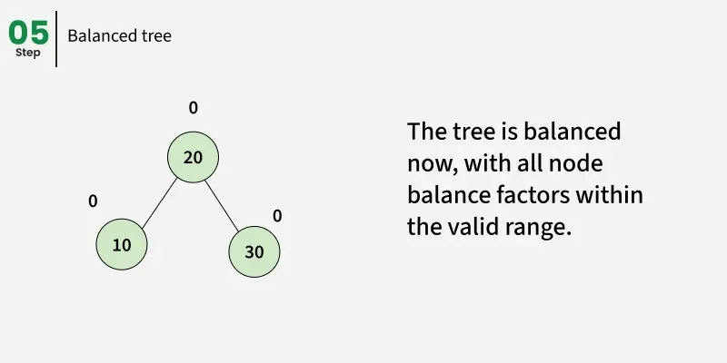

Slide 27
Advantages of AVL Tree
AVL trees can self-balance themselves and therefore provides time complexity as O(log n) for search, insert and delete.
As it is a balanced BST, so items can be traversed in sorted order.
Since the balancing rules are strict compared to Red Black Tree, AVL trees in general have relatively less height and hence the search is faster.
AVL tree is relatively less complex to understand and implement compared to Red Black Trees.

Slide 28
Why AVL Trees?
Most of the BST operations (e.g., search, max, min, insert, delete, floor and ceiling) take O(h) time where h is the height of the BST.
The cost of these operations may become O(n) for a skewed Binary tree.
If we make sure that the height of the tree remains O(log(n)) after every insertion and deletion, then we can guarantee an upper bound of O(log(n)) for all these operations.
The height of an AVL tree is always O(log(n)) , where n is the number of nodes in the tree.

Slide 29
Disadvantages of AVL Tree
It is difficult to implement compared to normal BST.
Less used compared to Red-Black trees. Due to its rather strict balance.
AVL trees provide complicated insertion and removal operations as more rotations are performed.

Slide 30
Insert Operation in AVL Tree
Insertion in an AVL Tree same as in a Binary Search Tree (BST):
A new key is placed in its correct position based on BST rules (left < node < right).
After the insertion, the balance factor of each node is checked during the path back up to the root. If any node becomes unbalanced (i.e., its balance factor not in range of [-1 , +1], a rotation is required to rebalance the AVL property.

Slide 31
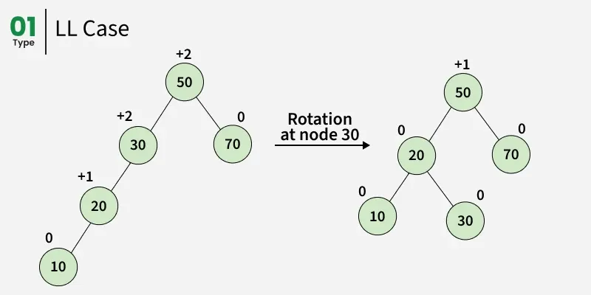

Slide 32
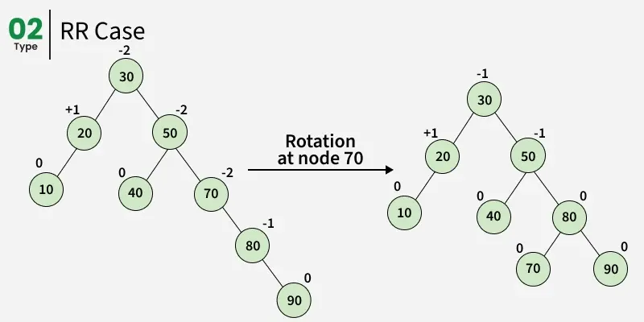

Slide 33
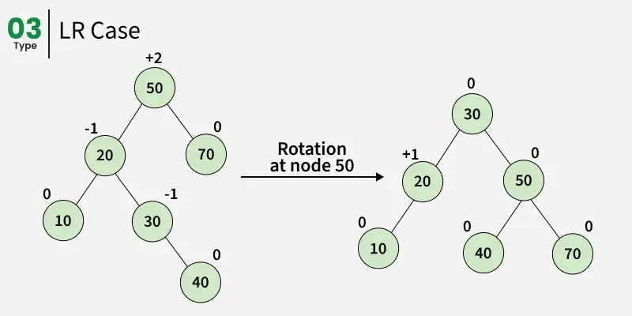

Slide 34
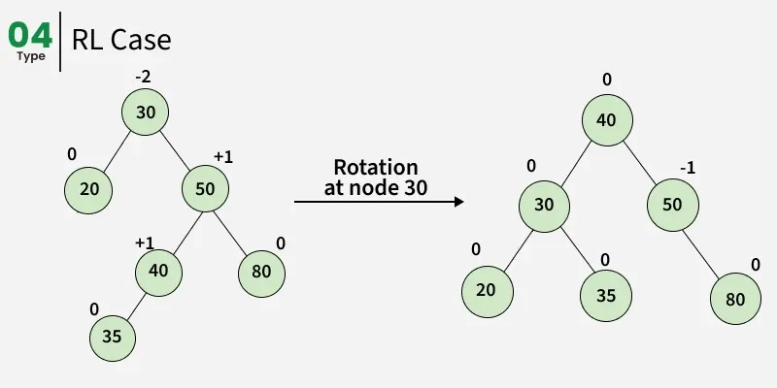

Slide 35
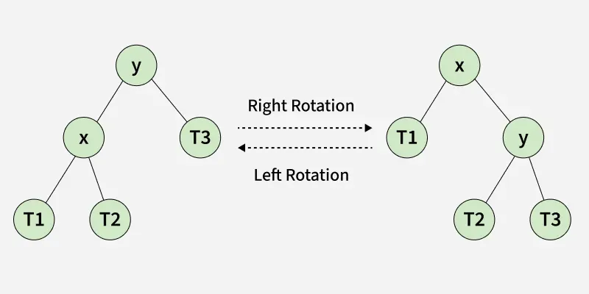
Left Rotation and Right Rotation

Slide 36
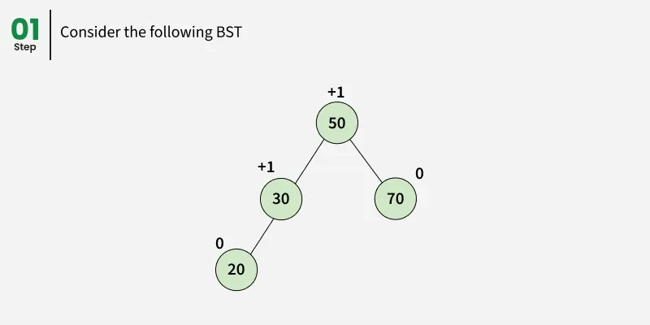

Slide 37
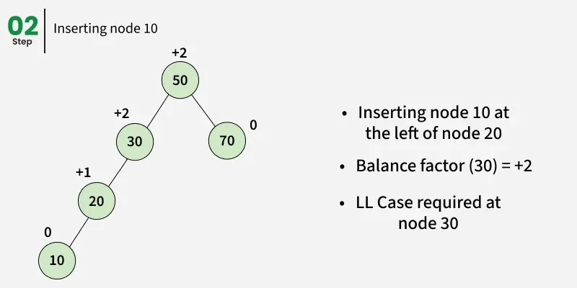

Slide 38
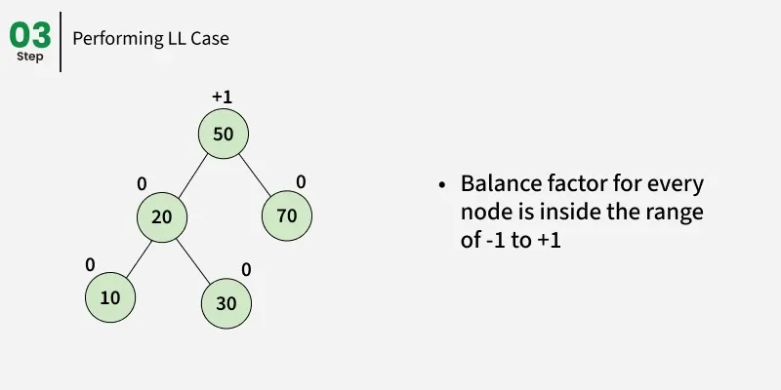

Slide 39
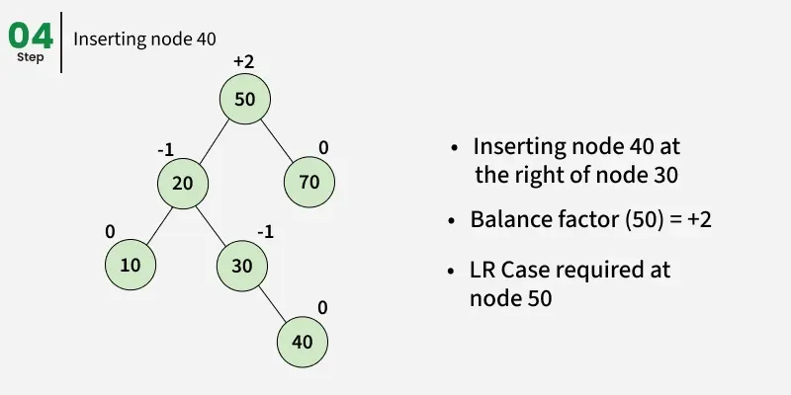

Slide 40
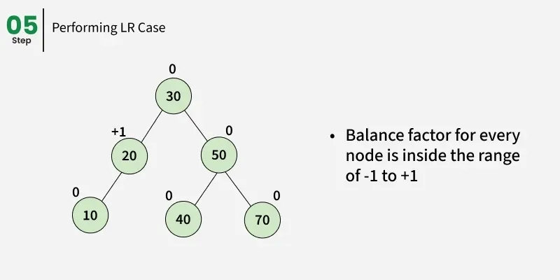

Slide 41
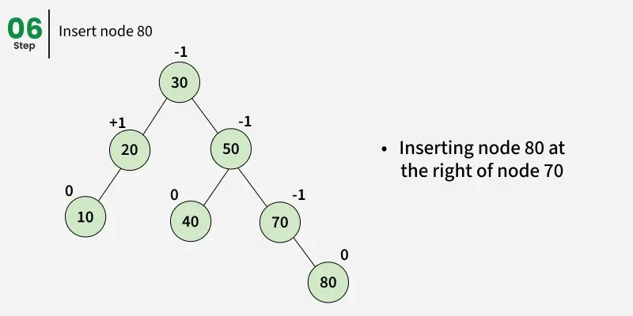

Slide 42
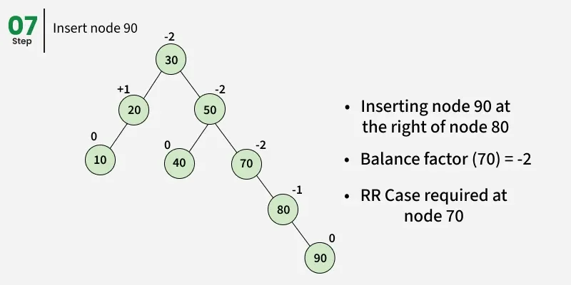

Slide 43
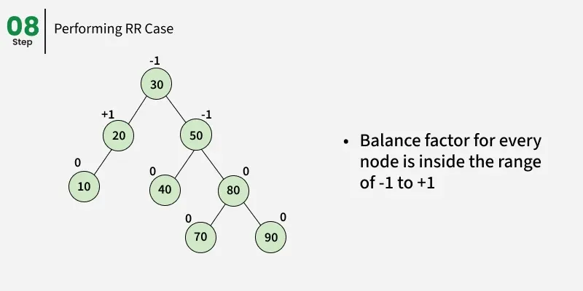

Slide 44
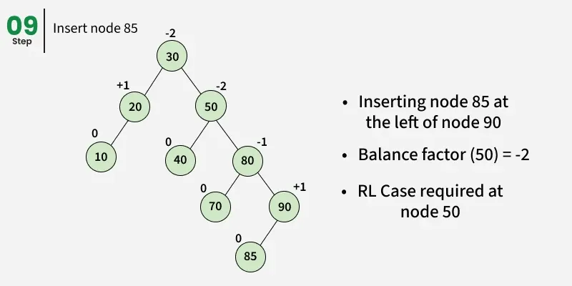

Slide 45
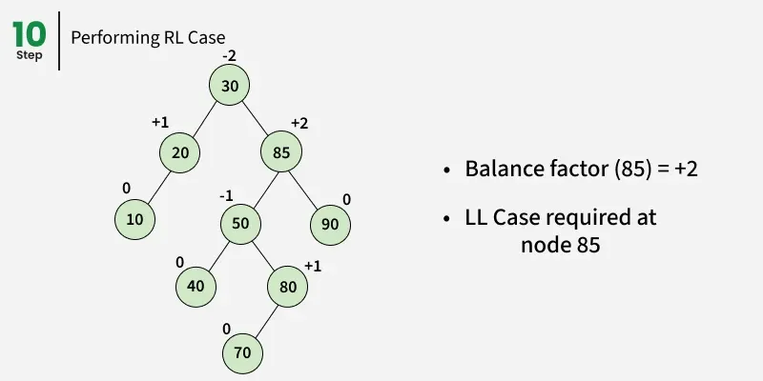

Slide 46
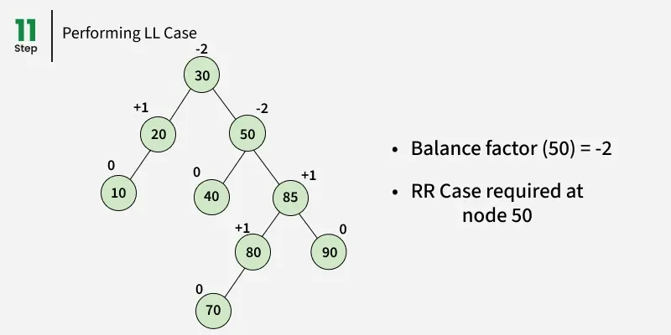

Slide 47
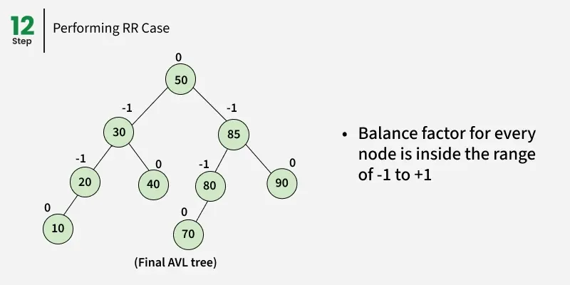

Slide 48
Insert Operation in AVL Tree
Perform the normal BST insertion.
The current node must be one of the ancestors of the newly inserted node. Update the height of the current node.
Get the balance factor (left subtree height - right subtree height) of the current node.
If the balance factor is greater than +1, then the current node is unbalanced and we are either in the Left Left case or left Right case.
To check whether it is left left case or not, compare the newly inserted key with the key in the left subtree root.
If the balance factor is less than -1, then the current node is unbalanced and we are either in the Right Right case or Right-Left case.
To check whether it is the Right Right case or not, compare the newly inserted key with the key in the right subtree root.

Slide 49
class Node {
int key;
Node left;
Node right;
int height;
Node(int data) {
key = data;
left = null;
right = null;
height = 1;
}
}

Slide 50
class AVLTree {
int height(Node N) {
if (N == null)
return 0;
return N.height;
}
Node rightRotate(Node y) {
Node x = y.left;
Node T2 = x.right;
// Perform rotation
x.right = y;
y.left = T2;
y.height = 1 + Math.max(height(y.left), height(y.right));
x.height = 1 + Math.max(height(x.left), height(x.right));
return x;
}

Slide 51
Node leftRotate(Node x) {
Node y = x.right;
Node T2 = y.left;
// Perform rotation
y.left = x;
x.right = T2;
// Update heights
x.height = 1 + Math.max(height(x.left), height(x.right));
y.height = 1 + Math.max(height(y.left), height(y.right));
// Return new root
return y;
}

Slide 52
// Get balance factor of node N
int getBalance(Node node) {
if (node == null)
return 0;
return height(node.left) - height(node.right);
}

Slide 53
// Recursive function to insert a key in the subtree rooted with node
Node insert(Node node, int key) {// Perform the normal BST insertion
if (node == null) return new Node(key);
if (key < node.key) node.left = insert(node.left, key);
else if (key > node.key) node.right = insert(node.right, key);
else // Equal keys are not allowed in BST
return node;
// Update height of this ancestor node
node.height = 1 + Math.max(height(node.left), height(node.right));
// Get the balance factor of this ancestor node
int balance = getBalance(node);

Slide 54
// If this node becomes unbalanced, then there are 4 cases
// Left Left Case
if (balance > 1 && key < node.left.key) return rightRotate(node);
// Right Right Case
if (balance < -1 && key > node.right.key) return leftRotate(node);
// Left Right Case
if (balance > 1 && key > node.left.key) {
node.left = leftRotate(node.left);
return rightRotate(node);
}
// Right Left Case
if (balance < -1 && key < node.right.key) {
node.right = rightRotate(node.right);
return leftRotate(node);
}
return node;
}

Slide 55
// A utility function to print preorder traversal of the tree
static void preOrder(Node root) {
if (root != null) {
System.out.print(root.key + " ");
preOrder(root.left);
preOrder(root.right);
}
}

Slide 56
Delete Operation in AVL Tree
Perform BST delete operation and some re-balancing.
Following are two basic operations that can be performed to re-balance a BST without violating the BST property (keys(left) < key(root) < keys(right)).
Left Rotation
Right Rotation

Slide 57
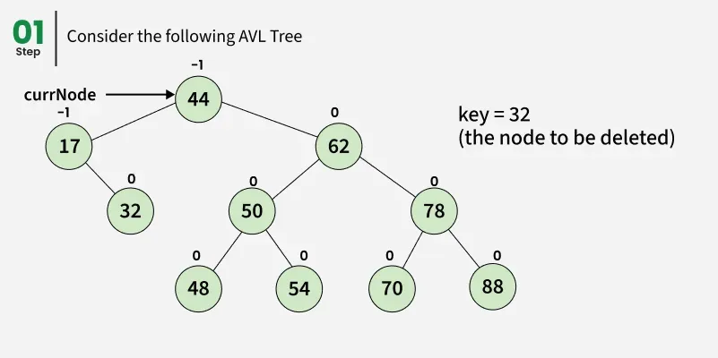

Slide 58
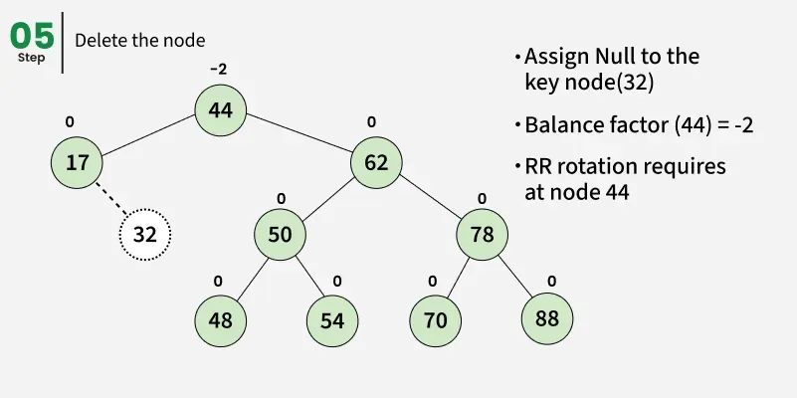

Slide 59
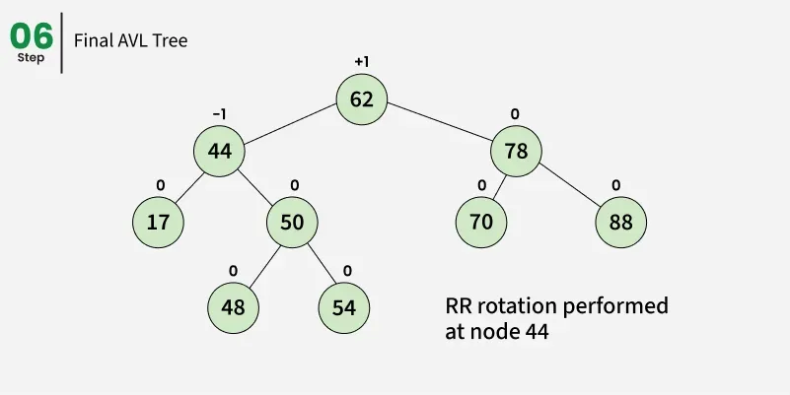

Slide 60
private Node minValueNode(Node node) {
Node current = node;
// loop down to find the leftmost leaf
while (current.left!= null)
current = current.left;
return current;
}

Slide 61
public Node deleteNode(Node root, int key) {
// STEP 1: PERFORM STANDARD BST DELETE
if (root == null) return root;
// If the key to be deleted is smaller than the root's key, then it lies in left subtree
if (key < root.key) root.left = deleteNode(root.left, key);
// If the key to be deleted is greater than the root's key, then it lies in right subtree
else if (key > root.key) root.right = deleteNode(root.right, key);
// if key is same as root's key, then this is the node to be deleted
else { // node with only one child or no child
if ((root.left == null) || (root.right == null)) {
Node temp = root.left!= null? root.left : root.right;
// No child case
if (temp == null) {
temp = root;
root = null;
} else // One child case
return temp;
} else {
// node with two children: Get the inorder successor (smallest in the right subtree)
Node temp = minValueNode(root.right);
// Copy the inorder successor's data to this node
root.key = temp.key;
// Delete the inorder successor
root.right = deleteNode(root.right, temp.key);
}
}
// If the tree had only one node then return
if (root == null)
return root;

Slide 62
// STEP 2: UPDATE HEIGHT OF THE CURRENT NODE
root.height = 1 + Math.max(height(root.left), height(root.right));
// STEP 3: GET THE BALANCE FACTOR OF THIS NODE (to check whether this node became unbalanced)
int balance = getBalance(root);
// If this node becomes unbalanced, then there are 4 cases
// Left Left Case
if (balance > 1 && getBalance(root.left) >= 0)
return rightRotate(root);
// Left Right Case
if (balance > 1 && getBalance(root.left) < 0) {
root.left = leftRotate(root.left);
return rightRotate(root);
}
// Right Right Case
if (balance < -1 && getBalance(root.right) <= 0)
return leftRotate(root);
// Right Left Case
if (balance < -1 && getBalance(root.right) > 0) {
root.right = rightRotate(root.right);
return leftRotate(root);
}
return root;
}

